Slide 1


Special Education Hot Topics for Review for Special Education Staff
District-Wide Professional Development
Friday, October 14, 2016
Forest Park Community College – Mildred Bastian Theatre
8:00 a.m. – 11:00 a.m.

Slide 2

Sign-In outside Theatre
Report to schools for site-based PD in the afternoon
Swipe-out at the end of the day (3:30 pm)

Slide 3
Please Silence
ALL Electronic Devices
During the Session.
Thank you.

Slide 4
TRANSFER DOCUMENTATION

Slide 5
Legal Requirements
IDEA (Regulations: section 300.323) when IEP’s must be in effect
MO State Plan for Special Education (Section IV)
SPED Compliance: Program Review Standards and Indicators
In-State (500.10 – 500.290)
Out-of-State (550.10 – 550.270)
Helpful Resource: Transfer Doc FAQ https://dese.mo.gov/sites/default/files/TransferWebinarQuestionsAnswers.pdf

Slide 6
The Transfer Process

Slide 7
Gaining information
Records
Receiving School: Request
within two (2) days of
Enrollment
Sending School: Send within
five (5) business days of
receiving request for records
Notes:
- Begin the Transfer Documentation as soon as alerted to student

Slide 8
Gaining information
Interview
Receiving School: Talk with
parents and staff from
sending school
Sending School: Share
information about student’s
evaluation and IEP

Slide 9
There are times when the parent does not disclose that their child has an IEP. Are we out of compliance if we discover after the time limits that the student is indeed an IEP student?
This is why it is so important to have enrollment procedures in place to “screen” to determine if the student who is transferring has an IEP.
If the parents do not share this information on the enrollment form, then the district does not have any reason to suspect that the student has an IEP at that point. However, once the student’s records are received from the sending school district, a review of those records should find some documentation such as an IEP or Evaluation Report. At that point, the receiving district has reason to suspect and would need to follow the transfer process.
Notes:
Check with the

Slide 10
I have a transfer student, what do I do…
Check with the secretary/enrollment clerk Weekly regarding new
students
Investigate in SIS
    Old AND Retired SIS
Always request an official copy of records from sending District within 2 days of enrollment

Slide 11
Beginning the Transfer Process
Is there reason to suspect that the new student is a
student with a disability who was receiving or had
previously received special education
services based on enrollment paperwork,
interviews and/or student records?
YES
Is the student transferring from In-State or NO Enroll the student in general
Out-of-State? Be sure to use the correct education following district
form so that you follow the required policies
compliance procedures for the type of
transfer of your student

Slide 12
Decisions about the IEP
Accept = Implement Exactly As Written
Reject = provide
comparable services
until new annual IEP
is developed
NO IEP NO
Amendment Interim
to Transfer IEP
IEPs

Slide 13
Is it best practice to reject all incoming IEP’s from other districts?
It’s not a matter of best practices. What is required is that a determination must be made by the district of “is the IEP compliant and can it be implemented as written?”
  If the answer is “yes”, then the district accepts the IEP – If the answer is “no” then you follow the steps in the process

Slide 14
What are “Comparable Services"
This would include the special education and related services
listed on the student’s IEP from the sending school district
The receiving school will need to provide those same services,
as closely as possible, to the student in their new school
It is important to consult with the parent in this process and
to be very clear on what the comparable services will be
Notes:
- Speak to Transportation as a Related Service for REJECTED IEPs

Slide 15
Can you Amend a Transfer IEP?
No. If you cannot implement the IEP exactly as written, you
must reject the IEP.
It is important to remember that you cannot amend a transfer
IEP – your only options are:
    To accept the transfer IEP and then implement all of that IEP exactly as written or
    To reject the IEP and to develop a new IEP or provide comparable services until the new IEP is developed

Slide 16
Is it acceptable to write an Interim IEP for transfer students?
There is no such thing as an interim IEP
IEP’s can be the initial IEP (i.e., first one ever written
for a student) or annual IEP’s (i.e., the IEP is written after
the first IEP).

Slide 21
Transfer Scenarios

Slide 22

No Evaluation Report and No IEP
Did a review of information on enrollment form
indicate the student was receiving or had previously
received special education services?
YES NO Enroll in general ed
Did interviews indicate there is any reason to suspect
that the student has a disability?
YES NO Enroll in general ed
Handled differently for in-State and out-of-State

Slide 23
No Evaluation Report and No IEP
(In-State Transfer)
In-State
Provide comparable services
If evaluation report is received within 30 days of enrollment
Review and determine to Accept or Reject
If Accepted, convene IEP team to develop annual IEP
If Rejected, initiate reevaluation and proceed as noted below
If evaluation report is not received within 30 days of
enrollment, initiate reevaluation
If eligible, convene IEP team to develop annual IEP
If ineligible, provide Notice of Action to parents

Slide 25
No Evaluation Report and No IEP
(Out-of-State Transfer)
Out-of-State
MAY provide comparable services but not required
unless there is sufficient reason to suspect a disability
Initiate initial evaluation
If eligible, convene IEP team to develop annual IEP
If ineligible, provide Notice of Action to parents

Slide 27
Evaluation Report Received, No IEP
Is the evaluation report compliant and does it contain all
information to determine eligibility in Missouri?
REJECT ACCEPT In-State:
Develop annual IEP ASAP
Must provide comparable services if any delay
In-State: Out-of-State:
Initiate reevaluation
Must provide comparable services Develop annual IEP ASAP
until eligibility is determined
Out-of-State:
Initiate initial evaluation
May provide comparable services
until eligibility is determined

Slide 32
IEP Received, No Evaluation Report
Is the IEP compliant and can it be implemented as written
without any revisions?
REJECT ACCEPT In-State AND Out-of-State:
Implement IEP
In-State and Out-of-State
IEP:
Develop new annual IEP Evaluation Report:
Must provide comparable If evaluation report received within 30 days:
services until new IEP Accept OR Reject and
is developed or child initiate reevaluation (in-State) OR initial evaluation (out-of-State)
determined ineligible for If no evaluation report received within 30 days:
services Initiate reevaluation (in-State) OR initiate initial evaluation (out-of-State)

Slide 39
Both IEP and Evaluation Report Received
Is the evaluation report compliant and does it contain all
information to determine eligibility in Missouri?
(NO) REJECT (YES) ACCEPT
Is the IEP compliant and can it be
Implemented as written without any revisions?
(NO) REJECT
In-State:
Initiate reevaluation
Must provide comparable
services until eligibility is Develop new annual IEP
Determined Must provide comparable services
Out-of-State: if delay in developing new IEP
Initiate initial evaluation
May provide comparable (YES) ACCEPT Implement IEP as written
services until eligibility is
determined

Slide 44
ATTACHMENTS
Interview with Parent/Guardian/Student (18+)
Interview with LEA Staff Person from Sending District (e.g. counselor, process coordinator, sped director, sped teacher, etc.)
Comparable Services Documentation Form
(To be used in conjunction with Section 3, 4 or 5 of the Transfer Documentation Form)

Slide 45
When are interviews required in the transfer process?
Interviews with the sending school district would be required
in all situations
    Document the conversation on the “Interview Information Documentation Form”

Slide 46
Once the appropriate information has been entered in the Transfer Documentation Band:
- The school psych enters accepted evaluations
- The case manager enters the accepted IEP
This will populate the Current Special Education Summary in SIS

Slide 47
Evaluation Band
The Psychological Examiner/Psychologist must enter the evaluation information. This will show the child has a current identification.
Notes:
- If the psych does not

Slide 48
IEP Band
The case manager will need to open a Working Draft and enter the following information:
• Special Education Abstract page
    IEP Date
    Next IEP Date
    Initiation Date
• State and Federal Requirements (if MAP-A, ESY eligible)
• Services Summary page
• Transportation page
• Placement
• MAP-A (if Applicable)
• ESY (if Applicable)

Slide 49
Email your Special Education Process Coordinator to have the IEP Marked as Complete and Approved
Import the sending districts documents into the Imported Documents Band
Alert psych examiner/psychologist and all related service providers VIA e-mail that a document requires review

Slide 50
Hot Topics: IEP Implementation
                Present Level of Academic Achievement and Functional Performance
                Special Considerations: Federal & State Requirements (ESY, BIP)
                Goals & Objectives
                Services Summary & Reporting Progress
                Transportation as a Related Service
                Assessments
                Transition
                Regular Education Participation & Placement Considerations
                Accommodations & Modifications
                Supplemental Aides & Services (Para Support)

Slide 51

IEP Implementation: PLAAFP
Present Level of Academic Achievement and Functional Performance
    ROAD MAP and Foundation of the IEP
    Describes how the educational diagnosis affects students involvement and participation in the school setting
      Be specific. Avoid broad/general statements
      Avoid adjectives without quantitative data/examples
    Identifies and prioritizes the specific needs of the student and establishes baseline performance in the general education curriculum
    Provides a description between the student’s current skill levels and the expectations of the student’s learning environment
    Specifies what the student has learned and accomplished
      Academic and Non-Academic, where applicable

Slide 52
IEP Implementation: PLAAFP (continued)
Present Level of Academic Achievement and Functional Performance
    Reports progress in the general education curriculum (examples may include grades, group participation rates, task and project completions, etc.)
    Reports school staff concerns
      Academic and non-academic, where applicable
    Includes student reported concerns, as appropriate. Student participation is encouraged at any age but is mandated when transition is being addressed. (Refer to Form C: Transition Services Plan)
    Include assessment of the student's progress toward goals on the previous IEP.
    Include prior interventions and explain data indicating their effectiveness or ineffectiveness
    Address transition, where appropriate

Slide 53
IEP Implementation: Special Considerations Page
Answer each question/section AND complete the corresponding sections in the IEP
    “Does the student exhibit behaviors that impeded his/her learning or that of others?”
      If yes, strategies and supports must be considered by the IEP team → If determined necessary, must be addressed in the IEP
      If a behavior intervention plan exists, it must be a part of the IEP
      Helpful Resource: DESE Functional Behavior Assessment (FBA)/Behavior Intervention Plan (BIP) FAQ: https://dese.mo.gov/special-education/compliance/fbabip-faqs
    Assistive Technology
      Includes low tech and high tech
        Examples: Low Tech = Communication Book/Picture Exchange , High Tech = Voice Out Device

Slide 54
IEP Implementation: Special Considerations Page
Answer each question/section AND complete the corresponding sections in the IEP
    “Extended School Year? (ESY)”
      If eligible, MUST complete Form-B
      If addressing at later date, MUST include the date ESY will be addressed
      Helpful Resource: DESE ESY: https://dese.mo.gov/special-education/compliance/extended-school-year-policies
    Transfer of Rights
      Initial date given remains same in each sequential IEP

Slide 55
IEP Implementation: Special Considerations Page
Transfer of Rights
    “Does the student exhibit behaviors that impeded his/her learning or that of others?”
      If yes, strategies and supports must be considered by the IEP team → If determined necessary, must be addressed in the IEP
      If a behavior intervention plan exists, it must be a part of the IEP
      Helpful Resource: DESE Functional Behavior Assessment (FBA)/Behavior Intervention Plan (BIP) FAQ: https://dese.mo.gov/special-education/compliance/fbabip-faqs
    “Extended School Year? (ESY)”
      If eligible, MUST complete Form-B
      If addressing at later date, MUST include the date ESY will be addressed
      Helpful Resource: DESE ESY: https://dese.mo.gov/special-education/compliance/extended-school-year-policies

Slide 56
IEP Implementation: Goals & Objectives
Instructionally relevant
Written in observable, measurable terms
Written in terms that parents and professionals can understand
Linked directly to areas identified within the student’s PLAAFP
Achievable in relationship to the student’s rate of progress, strengths, and needs as identified in the PLAAFP
Enables the student to be involved in the general education curriculum, and for ESCE/Preschool, participate in appropriate activities

Slide 57
IEP Implementation: Goals & Objectives (continued)
  Time-bound… reasonably calculated to be accomplished in one year
  Include a description of benchmarks or short-term objectives aligned to achievement &
  alternate achievement standards, for students taking alternate assessments
  Remember to write SMART Goals → Specific + Measurable + Attainable + Relevant + Time-
  Bound
  Helpful Resource:
    DESE Goal FAQ: https://dese.mo.gov/faqs/measurable%20goals%20&%20objectives
  Should be a goal written for EVERY service listed on the Services Summary Page

Slide 58
IEP Implementation: Services Summary & Reporting Progress
Reporting Progress Section
  Include how often progress will be reported to parent
    St. Louis Public Schools reports progress every 5 weeks (Bi-Quarterly)
Services Summary Section
  Services must be tied to PLAAFP
  Services must include amount, frequency and location
  Compensatory services listed separately
  Supplementary Aides/Services
    Para Support Minutes
    Consult Services (i.e., AAC Access, OT/PT/SLP consult, etc.)
Notes:
- Para minutes are listed on the Services Summary Page under Supplemental aides and services
- Consult services are listed on the Services Summary Page under Supplemental aides and services

Slide 59

IEP Implementation: Transportation as Related Services
Provided when students with disabilities cannot get to school to school in the same manner as non-disabled peers
Includes travel to and from school and between schools
Decisions must be made on individual basis not on a disability category or parent
request
    If IEP team determines that the student’s disability does not
    impact his/her ability to self-transport, but the parent requests
    transportation for their child, transportation is NOT provided or
    included in the IEP
Notes:
- If the IEP team determines that the student qualifies for transportation as a relates services, but the parents refuse, the decision is noted on the IEP Multipurpose Page

Slide 60

IEP Implementation: Transportation as Related Services
Justification must be thoroughly documented in the PLAAFP
    Nature and extend of disability which lends itself to the need for transportation as a related service
Need must be discussed and determined ANNUALLY by the IEP TEAM
  Not automatic once written into IEP

Slide 61
IEP Implementation: Transportation as Related Services
Special Transportation Worksheet must be completed in EVERY instance PRIOR to including in IEP

Slide 62
IEP Implementation: Paraprofessional Consideration
Para Support Recommendation - Complete and submit the Paraprofessional Consideration
Form PRIOR to IEP

Slide 63
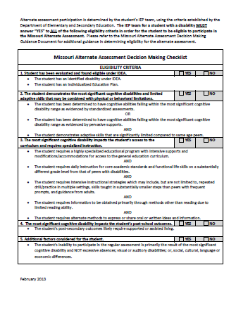
IEP Implementation: Assessment
MAP-A
  DESE Criteria - Flowchart (Feb 2013)
  DESE Criteria – Eligibility (Feb 2013)
IEP MEETING
Eligibility
Reporting
Teaching
Essential Elements
Goals
Assessment
Embedded Testing
Spring Testing

Slide 64
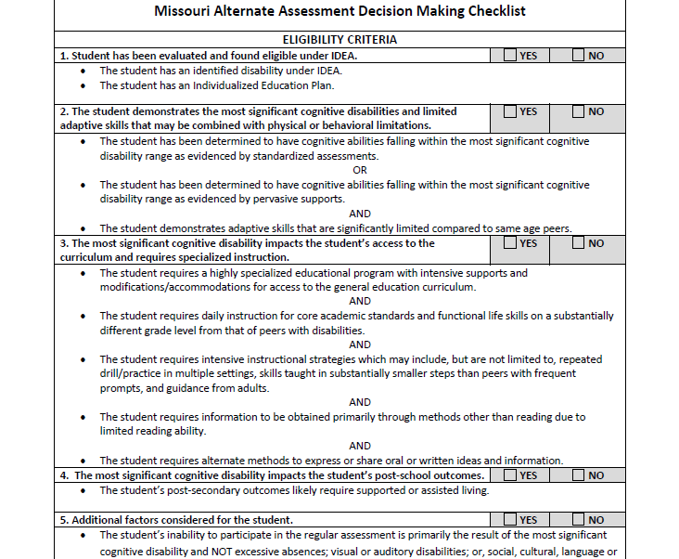

Slide 65
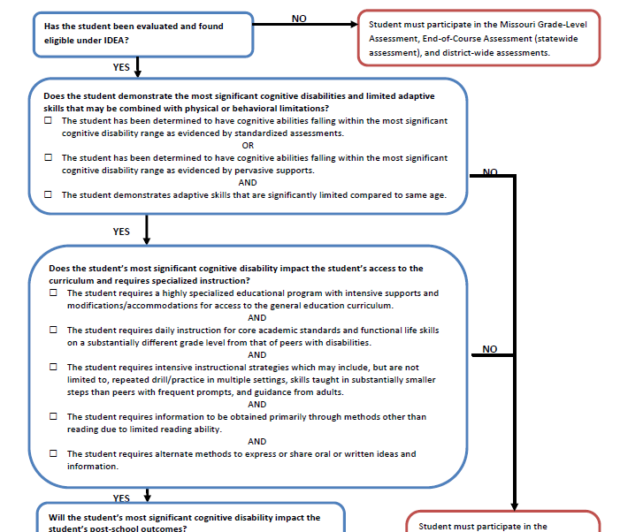

Slide 66

IEP Implementation: Assessment
ACT
Accommodations
DUE March 10, 2017 Complete Accommodation Requests
EOC
DSGLA
REPORTING
ELL
Special Considerations Page
WIDA-A
12th Grade
  Helpful Resource: DESE Alternative Assessment Question & Answer
    https://dese.mo.gov/sites/default/files/webinar/documents/QAfromAlternateAssessmentwebinar-Final.pdf

Slide 67
IEP Implementation: Regular Education Participation & Placement
Regular Education Participation must include
  Extent to which student will not participate in regular education environment
  Minutes or % of special education and related service minutes on the IEP
  A description of reasons why the IEP team determined service provision in the regular education setting was not appropriate
    Utilize information in PLAAFP, which explains how the student’s disability affects
    involvement and performance in GEC
Placement
  IEP teams must always consider the general education classroom first
  Decisions cannot be made solely on disability category, name of the room and/or name the building in which the student receives services

Slide 68
IEP Implementation: Regular Education Participation & Placement
Placement (continued)
  Consider Least Restrictive Environment (LRE) at All times
    LRE = To the maximum extent appropriate, students with disabilities must be educated with students who do not have disabilities”
  Determined annual by IEP team based on special education service minutes
  Minutes ARE NOT tailored to “FIT” a desired/preferred placement

Slide 69

IEP Implementation:
Post-Secondary Transition Planning:
Indicator 13 and assessments
Developing a better understanding of what is required for compliance with Indicator 13 (Letter of Law)

Slide 70

Indicator 13 Questions (Letter of Law)
NSTTAC Checklist - Indicator 13 items
  Student invite
    Is there evidence that the student was invited to the IEP team meeting?
  Outside agency invite
    If appropriate, is there evidence that a representative of any participating agency was invited to the IEP Team meeting with the prior consent of the parent or student who has reached the age of majority?
  Measurable Post-Secondary Goals (MPG’s)
    Is there an appropriate measurable post-secondary goal or goals that cover:
                Education
                Training
                Employment, and
                As needed, independent living

Slide 71
Indicator 13 Questions (Letter of Law)
NSTTAC Checklist - Indicator 13 items
Measurable Post-Secondary Goals (MPGs) updated annually
  Is (are) the post-secondary goals updated annually?
Annual IEP goals related to transition services
  Is (are) there annual IEP goal(s) related to the student’s transition service needs?
Age appropriate transition assessments
  Is there evidence that the measurable postsecondary goals were based on age-appropriate transitions assessments?
      C, D or E Assessment Forms INSERT FORMS

Slide 72
Indicator 13 Questions (Letter of Law)
NSTTAC Checklist - Indicator 13 items
MPG’s updated annually
  Is (are) the post-secondary goals updated annually?
Annual IEP goals related to transition services
  Is (are) there annual IEP goal(s) related to the student’s transition service needs?
Age appropriate transition assessments
  Is there evidence that the measurable postsecondary goals were based on age-appropriate transitions assessments?
      C, D or E Assessment Forms

Slide 73
Indicator 13 Questions (Letter of Law)
NSTTAC Checklist - Indicator 13 items
Question 4: Transition services
  Are there transition services in the IEP that will reasonably enable the student to meet his or her postsecondary goal(s)?
Question 5: Course of study
  Do the transition services include courses of study that will reasonably enable the student to meet his or her postsecondary goal(s)?
Does the IEP meet Indicator 13 requirements?

Slide 77
Spirit vs Letter of the LAW
Focus IDEA Regulations
Identify regulation and compliance
Narrow Impact on Adult Outcomes for SWD
*Understands IDEA intent
*Identify Possibilities for a quality adult life
*Expand Transition Planning & Services focus
*Greater Impact on Adult Outcomes for SWD
LETTER of the LAW: Narrow Impact
SPIRIT of the LAW: Larger Impact
Transition Coalition: Module-Transition Planning
Notes:
Effective transition planning requires that you focus on both complying with the letter of the law and also understanding the spirit and intent of IDEA to prepare students to attain quality adult-life outcomes. While paperwork is a necessity, the goal is to successfully plan for a quality adult life.
The real measure of your work will be how successful your students are in real life!

Slide 78
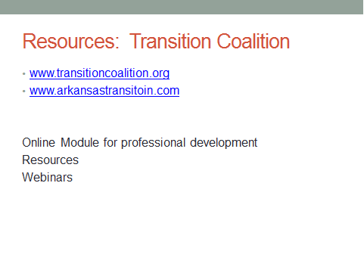

Slide 79

IEP Implementation: Accommodations & Modifications
Best practice is to ensure students have been provided
maximum accommodations prior to making
modifications to the curriculum
Based on student’s individual needs
What is necessary for maximum involvement and
participation in the academic setting
Consider a Continuum of Support → Minimal amount of
support needed for student to be successful
Select only those supports which are deemed necessary

Slide 80
IEP Implementation: Accommodations & Modifications
What is the difference???
 | ACCOMMODATIONS | MODIFICATIONS
Classroom Instruction | Can help students learn the same material and meet the same expectations as their classmates. If a student has reading issues, for example, she might listen to an audio recording of a text. There are different types of classroom accommodations, including presentation (like listening to an audio recording of a text) and setting (like where a student sits) | Children who are far behind their peers may need changes, or modifications, to the curriculum. For example, a student could be assigned shorter or easier reading assignments. Kids who receive modifications are not expected to learn the same material as their classmates

Slide 81
IEP Implementation: Accommodations & Modifications
What is the difference???
 | ACCOMMODATIONS | MODIFICATIONS
Classroom Tests | Testing accommodations can be different from those used for instruction. For example, using a spell-checker might help a student with writing difficulties take notes during class but wouldn’t be appropriate during a weekly spelling test. However, this student might benefit from extra time to complete the spelling test or using typing technology if the physical act of writing is difficult | Modifications in testing often involve requiring a student to cover less material or material that is less complex. For example, in the case of the spelling test, if the class was given 20 words to study, the student with modifications might only have to study 10 of them. Or she might have a completely different list of words

Slide 82
IEP Implementation: Accommodations & Modifications
What is the difference???
 | ACCOMMODATIONS | MODIFICATIONS
Standardized Testing | Statewide assessments allow certain accommodations like extra time or taking a computerized exam. Ideally these are the same accommodations a child uses to take class tests | Some students take an “alternate assessment” of their statewide test, which includes modifications to the regular test. The questions in this type of alternate assessment might not cover the same materials as the standard exams. Also, the results would be interpreted differently. Before you agree to an alternate assessment, find out how the results will be interpreted and what (if any) implications there will be for your child

Slide 83
IEP Implementation: Accommodations & Modifications
What is the difference???
 | ACCOMMODATIONS | MODIFICATIONS
Gym, Music and Art Classes | Accommodations for “special” classes like gym, music and art can be helpful. These are similar to accommodations for classroom instruction. Kids might get extra time to complete assignments or be allowed to complete them in a different format | If the school believes that an assignment within a class like gym, music or art is unreasonable for your child, modifications to that assignment are made. The gym teacher might modify the number of laps a student needs to run; the music teacher might not require a child to participate in the final performance. In some cases, students are even excused from certain classes in order to make time for one-on-one time with a specialist

Slide 84
IEP Implementation: Accommodations & Modifications
What is the difference???
Accommodations don’t always have to be formalized through an IEP
or 504 plan. They can be provided in the general education classroom
by the regular education teach
Teachers can provide informal accommodations
Notes:
Accommodate as much as possible before modifying!!!

Slide 85

E-Mail Professional Development questions to
  pd1014@slps.org
Complete the 8 question PD survey at
  https://www.surveymonkey.com/r/6QSR359
Pick-up PD certificates for attendance at conclusion

Slide 86

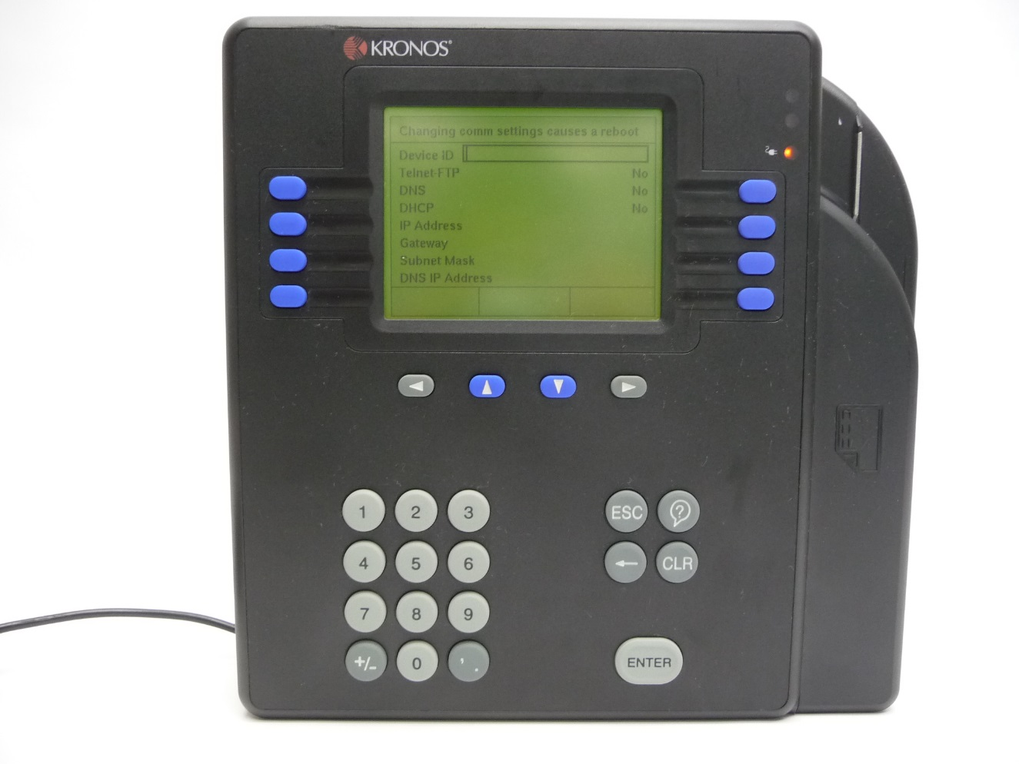
Report to schools for site-based PD after lunch
KRONOS
  Swipe-out at end of the day

